Slide 1
CAPSTONE PROJECT WEEK 5
NEW SPANISH CAFÉ ON A GREAT CITY OF INDIA

Slide 2
INDEX
1. INTRODUCTION…………………….. 3
2. DATA……………………………………… 4
3. METHODOLOGY……………………..10
4. M. LEARNING……………….…….…..13
5. RESULTS………………………………….14
6. DISCUSSION……………………………16
7. CONCLUSION………………………….18

Slide 3
1. INTRODUCTION
The objective of this project is to determine, through the study of the neighborhood data in one of the greatest towns on India, trying to check good locations for the start-up of a Spanish Café.
We need a multicultural and tourist character, with a great image in gastronomy, taking into account all the possible aspects, as population, financial, to extract a geographical candidate for our new restaurant.
Searching on data sources, Mumbai is our city for the study. It´s financial, commercial, and the entertainment capital of India. It is also one of the world's top ten centers of commerce in terms of global financial flow, generating 6.16% of India's GDP, and accounting for 25% of industrial output, and 70% of maritime trade in India. Mumbai Port trust over 70% of capital transactions to India´s economy. Mumbai has the eighth highest number of billonaries of any city in the world, and Mumbai's billionaires had the highest average wealth of any city in the world in 2008. The city houses important financial institutions and the corporate headquarters of numerous Indian companies and multinational corporations. It is also home to some of India's premier scientific and nuclear institutes. The city is also home to Bollywood and Marathi cinema industries. Mumbai's business opportunities attract migrants from all over India, and a great group of tourists, for all of this we considerer it a great candidate for the study and the start up of a new Spanish Café.

Slide 4
2. DATA RESOURCES & DATA MANAGEMENT
The essential data that we are going to require for the project will be:
2.1. Mumbai neighborhood data source
2.2. Geographical data and coordinates within Mumbai for those neighborhoods
2.3. Data management with recommendations

Slide 5
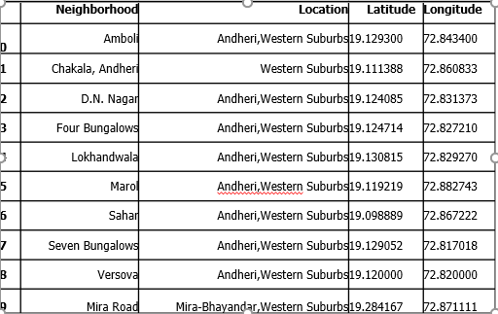
2.1. Mumbai neighborhood data source
The data of the Mumbai´s neighborhoods was scraped from https://en.wikipedia.org/wiki/List of neighborhoods in Mumbai. The data is read into a pandas data frame using the read_html_method. Doing so, is because Wikipedia page provides a group of detailed city tables with data that can be easily scraped using the read HTML method of pandas. Next picture shows a part of this data frame.

Slide 6
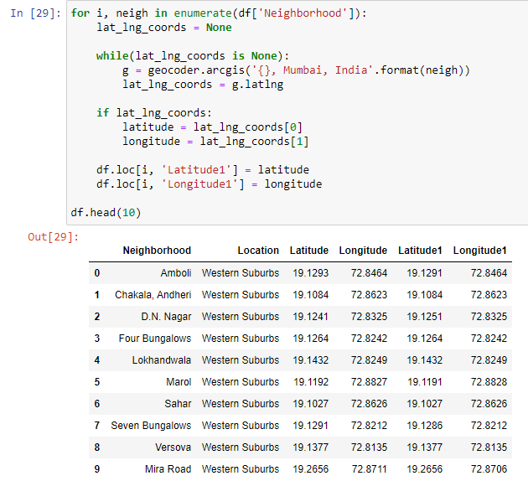
2.2. Geographical data and coordinates
Coordinates for Mumbai has been obtained from the GeoPy library in python. This data is relevant for plotting the map of Mumbai using the Folium library in python. The code for getting the geographical coordinates of Mumbai is the next picture.

Slide 7
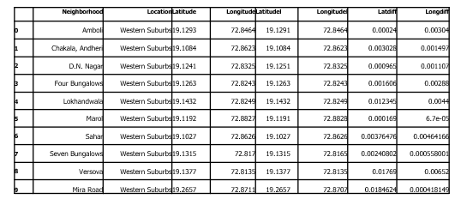
The geocoder library in python has been used to obtain latitude and longitude data for various neighborhoods in Mumbai. Cleaned coordinates are then further used for plotting neighborhoods using the Folium library in python. Nest picture shows the coordinates of neighborhoods in Mumbai obtained from Wikipedia source as ‘Latitude’ and ‘Longitude’ and those obtained from geocoder as ‘Latitudel’ and ‘Longitudel’.

Slide 8
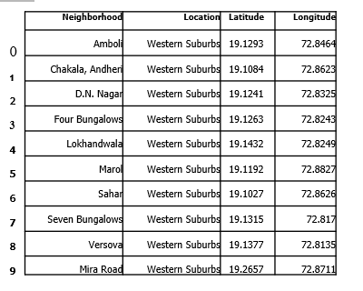
The new picture shows some lines of the final data frame after replacing the latitude and longitude values and cleansing unnecessary columns.

Slide 9
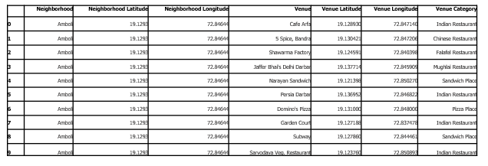
2.3. Data management with recommendations
The recommendations data has been extracted using the Foursquare API. This data contains recommendations for all neighborhoods in Mumbai and is used to study the popular venues of different neighborhoods as well as build the unsupervised learning model to cluster neighborhoods. Next figure shows some results using Foursquare API.

Slide 10
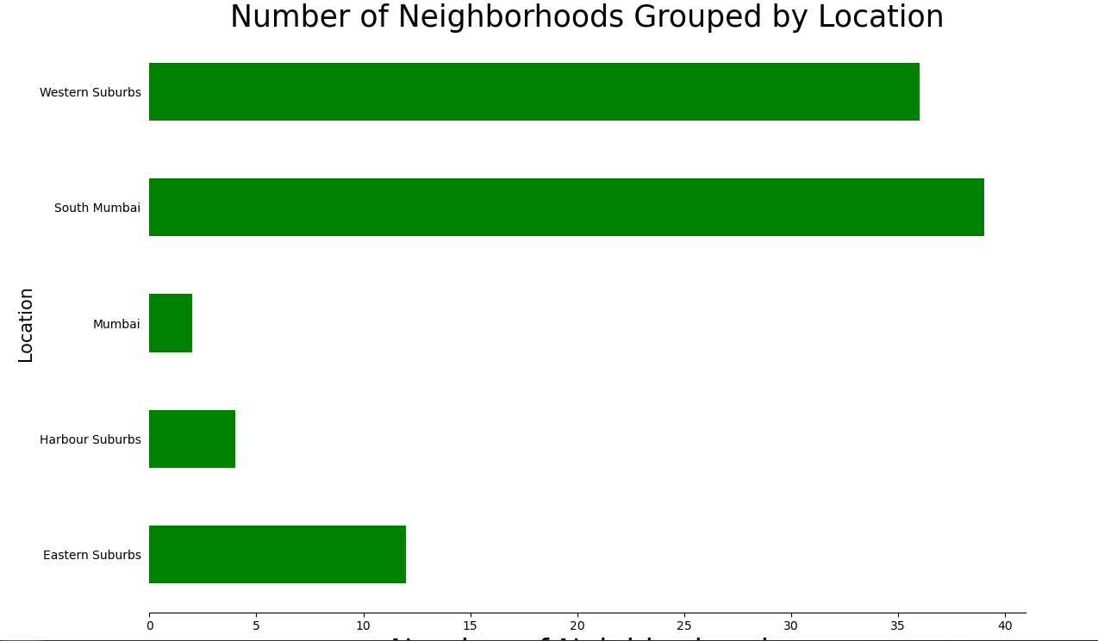
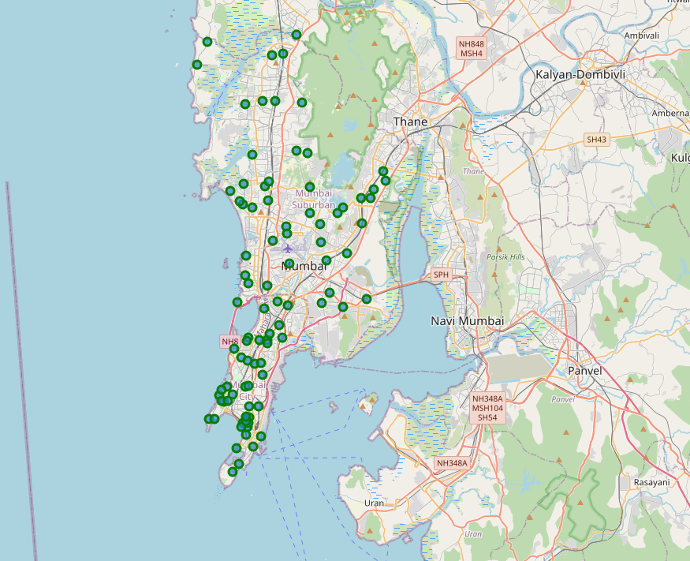
3. METHODOLOGY
3.1. VISUALIZATION
Visualization was carried out, see left picture shows with a bar plot depicting the number of neighborhoods in each location in Mumbai.
In the bar plot we can observe that South Mumbai and Western Suburbs have the most number of neighborhoods. Then using folium, a map was plotted to show how the different neighborhoods how are spread across Mumbai. This is shown in right picture.

Slide 11
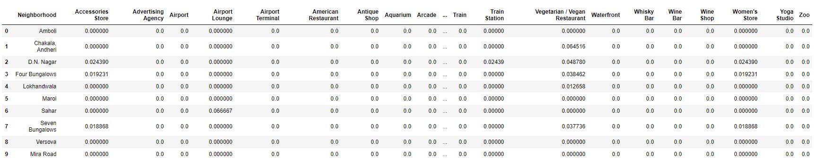
3.2. FEATURE EXTRACTION
Feature extraction was carried out to obtain features from the Foursquare API data (as shown in Figure 5) which was used for building the unsupervised learning model. In order to achieve this, the “Venue Category” column had to be converted to some form of numeric value to be used for building the model.
This was achieved by the One-hot Encoding method which takes all the unique categories and creates a column for each category.
This process was repeated for all venues in all neighborhoods and the result was a sparse matrix containing the neighborhood name and all unique category columns. This data frame was then grouped by the neighborhood name and the average value was taken for all categories. The result is shown in next picture.

Slide 12
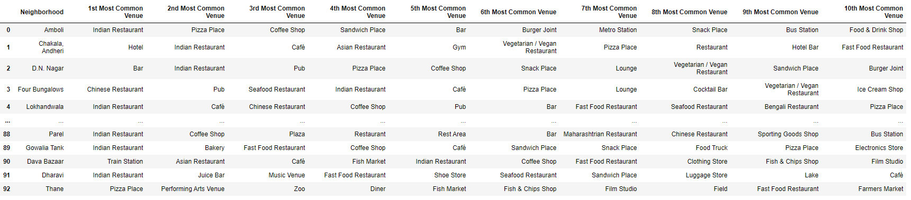
Notice that most of the values are 0 since there were a large number of unique categories and not all neighborhoods had venues belonging to each category. This data was used for the unsupervised learning model with the neighborhood name dropped. The unsupervised learning model is explained in the next section.
A data frame was also created which contained the top 10 most common venues of all neighborhoods. Though this is not a part of Feature Extraction, it is important to provide a glimpse into what this data frame looks like as it will be used later to combine the results from the unsupervised learning model. The top 10 rows of this data frame are shown in Figure 9.

Slide 13
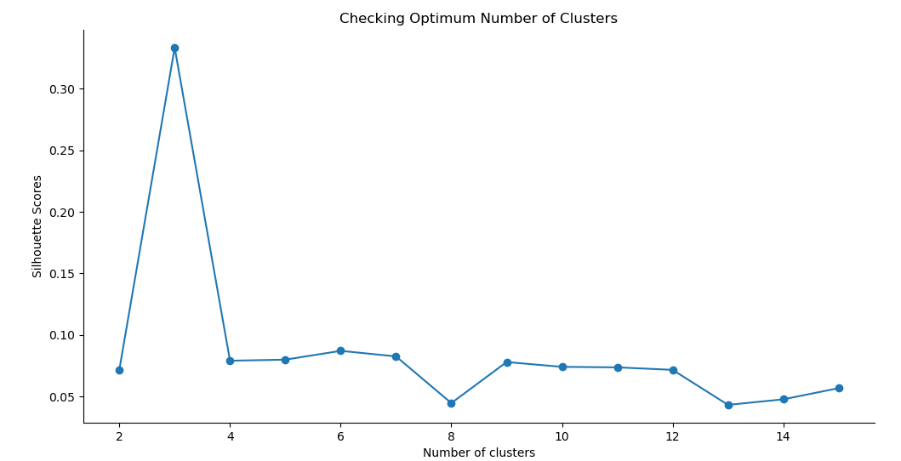
3.3. MACHINE LEARNING
K-means unsupervised learning technique was used to cluster the neighborhoods based on the category of venues near the neighborhoods. One important aspect of the k-means model is to determine the number of clusters to use in model development. This was determined by the Silhouette score which was calculated for a range of clusters from 2 to 15. The resulting number of clusters and their respective Silhouette scores are shown in the next picture.

Slide 14
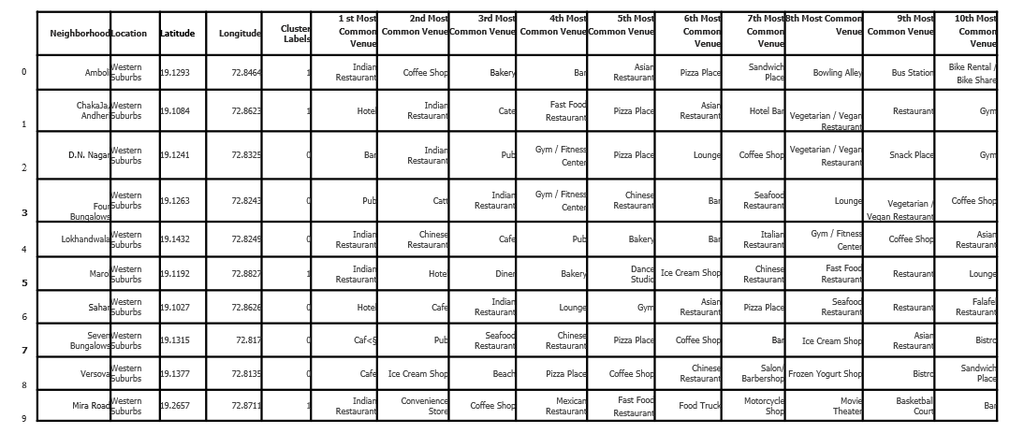
4. RESULTS
The Silhouette scores are not very high even as the number of clusters increases. This means that the inter-cluster distance is not very high over the range of k-values. Despite this, the data will be clustered to the best possible extent. The clustering model then clusters the neighborhoods in Mumbai and provides a label for each neighborhood which is representative of the cluster it belongs to. Coordinates and more date were added to the clustering table for a total representation as shown on the next picture.

Slide 15
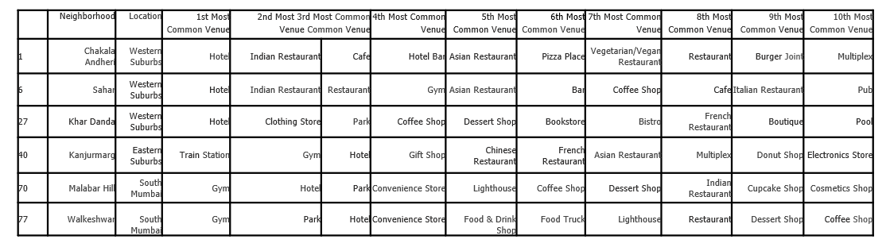
As result too, furthermore, neighborhoods in each individual cluster can be extracted using cluster labels and thus the details of specific clusters can be seen. This is done below for all clusters with only 10 rows for clusters that contain a high number of neighborhoods.

Slide 16
6. DISCUSSION
Based on the clusters shown above, the neighborhoods can once again be plotted on a map of Mumbai, however, this time with different color markers to distinguish between different clusters.
By analyzing the clusters obtained we can see that some of the clusters are more suited for restaurants and hotels, whereas, other clusters are less suited. Neighborhoods in clusters 3, 4, and 5 contain a small percentage of restaurants, hotels, cafe and pubs in their top 10 common venues. These clusters contain a higher degree of other venues like train station, bus station, fish market, gym, performing arts venue and smoke shop, to name a few. Thus, they are not well suited for opening a new restaurant. Comparing clusters 1 and 2, neighborhoods in cluster 1 seem to be more suited for starting a restaurant since they contains a larger percentage of food joints in the top 10 most common venues than cluster 2. The neighborhoods in cluster 1 contain a variety of food joints like restaurants, tea rooms, bakery, cafe, steakhouse and pubs and also contain very diverse cuisines like Japanese, Indian, Chinese, Italian and seafood restaurants. Recommended to open on cluster 1 as shown in the next picture.

Slide 17
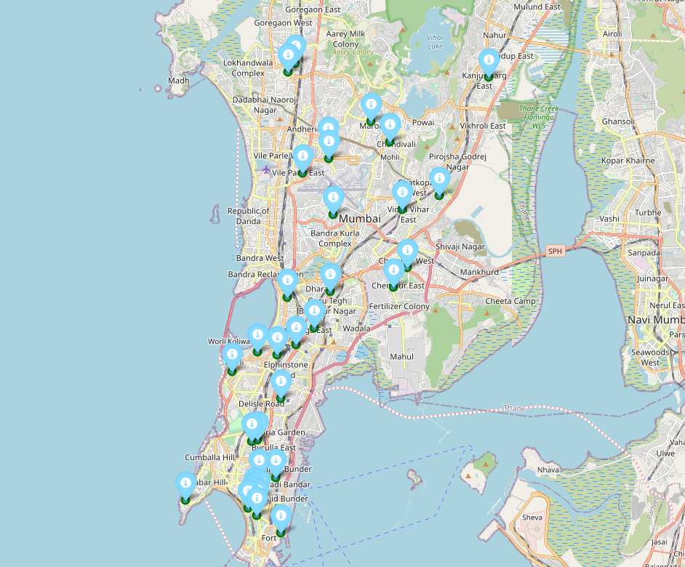

Slide 18
7. CONCLUSION
In this project, the neighborhoods in Mumbai, India have been successfully analyzed for determining which would be the best neighborhoods for opening a new Spanish restaurant. Based on the analysis carried out, neighborhoods in cluster 1 are recommended as locations for the new restaurant. This has also been plotted in the map in previous picture. The stakeholders could extract conclusions about the site, between other factors not specifically studied on this project, as economic or administrative factors.

